Slide 1
Assertions!
Applying the lessons of Heisenberg's breakthrough to human decision-making under uncertainty

Slide 2
Decision Making Under Uncertainty
“STEM careers are in demand.”
“Entry-level unemployment in technical fields remains elevated.”
“College is the safest long-term investment.”
“Trades outperform many degree pathways.”
“AI will replace administrative jobs.”
“Start a business and be your own boss.”

Slide 3
Capstone Project
The purpose is to construct an evidence-based model of possible future career pathways
  The objective is not to find the correct answer.
  The objective is to make the best possible recommendation using the evidence available at the time.

Slide 4
The Project Fibonacci Library
Source of Evidence for your Capstone Project
Assertions are Your Capstone Project Research Exercise

Slide 5
Types of Evidence
Decisions must consider evidence from Tier 1 primary sources whenever possible
  Tier 1 means -- High Empirical Rigor; primary sources.
  Tier 2 means -- Moderate Analytical/Interpretive Rigor.
  Tier 3 means -- Commentary / Exploratory Sources.
Evidence Rigor refers to source material; a Tier 3 source may still contain excellent insights, while a Tier 1 source may still contain uncertainty.
Notes:
Note 1. Credible sources may disagree. Disagreement does not invalidate the research process; it is often a sign of uncertainty in evolving systems.
Note 2. Evidence Rigor refers to source material; a Tier 3 source may still contain excellent insights, while a Tier 1 source may still contain uncertainty. Tier 1 means -- High Empirical Rigor; primary sources. Tier 2 means -- Moderate Analytical/Interpretive Rigor. Tier 3 means -- Commentary / Exploratory Sources.

Slide 6
What’s in the Library
Source | Description | URL | Document | Evidence Rigor
Stanford.edu | Canaries in the Coal Mine? Six Facts about the Recent Employment Effects of Artificial Intelligence | https://digitaleconomy.stanford.edu/wp-content/uploads/2025/08/Canaries_BrynjolfssonChandarChen.pdf | Yes | Tier 1
US BLS | Employment Projections by Occupation | https://data.bls.gov/projections/occupationProj | Yes – also available as a spreadsheet | Tier 1
NPR | Shift in manufacturing jobs from US to China | https://www.npr.org/sections/money/2021/11/02/1050999300/how-american-leaders-failed-to-help-workers-survive-the-china-shock | No – URL only | Tier 2

Slide 7
What is an Assertion?
Assertions are common beliefs regarding future career opportunities.
Three (3) questions will be provided to help you investigate the assertion.
Use the data sources and questions to help guide you in determining the validity of the assertion.

Slide 8
Exercise 1
Consider Brookings Institute report.
Consider US BLS employment projections.
Consider Anthropic projections.
What are these projections implying about routine tasks?

Slide 9
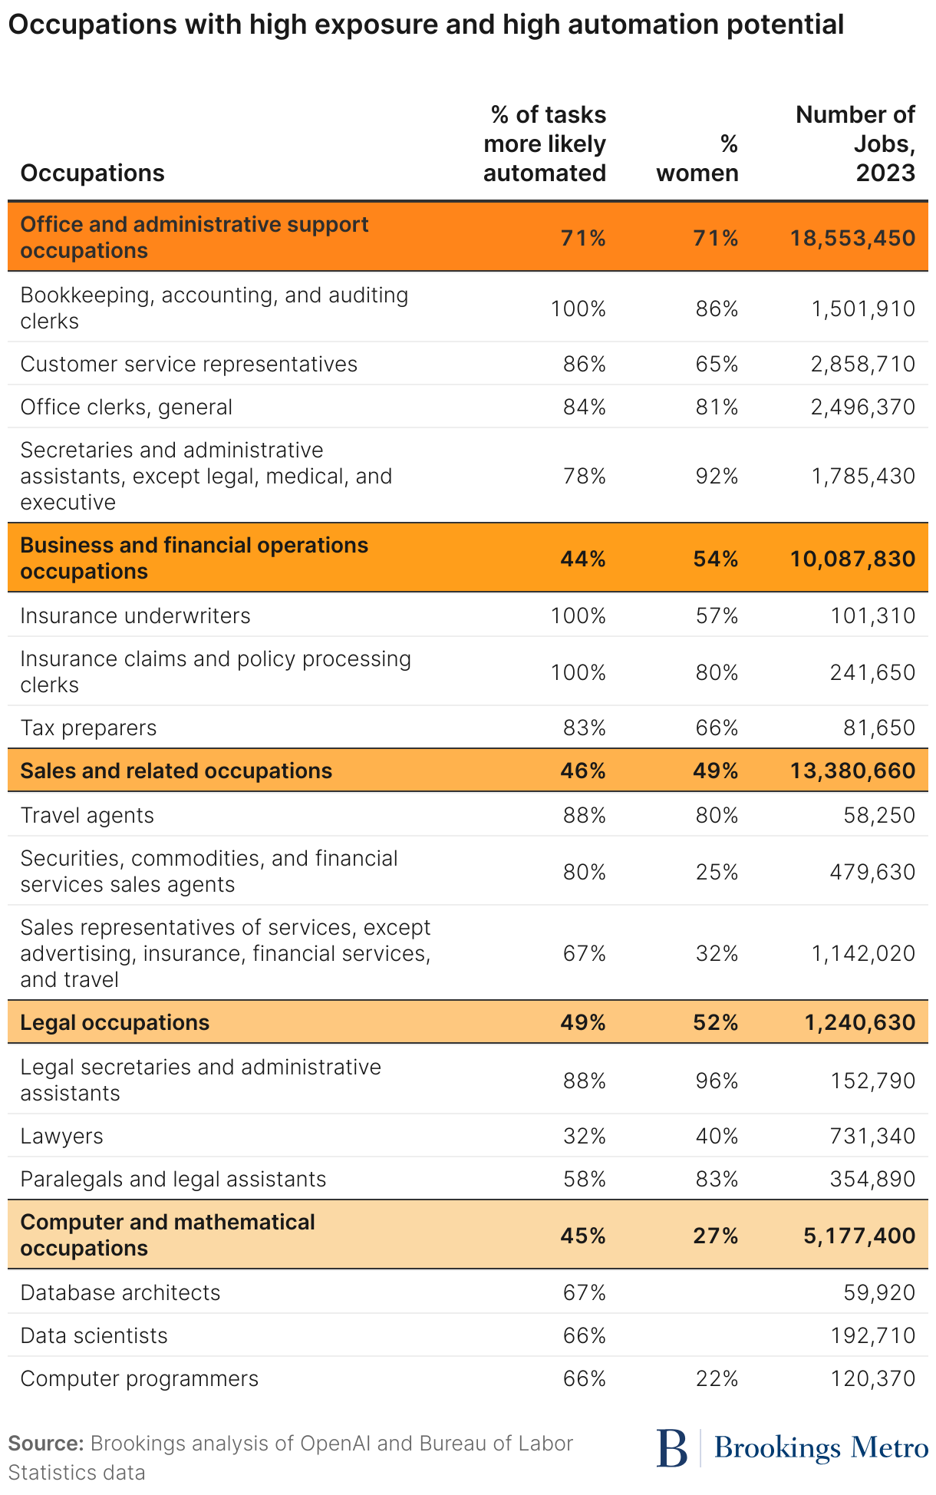
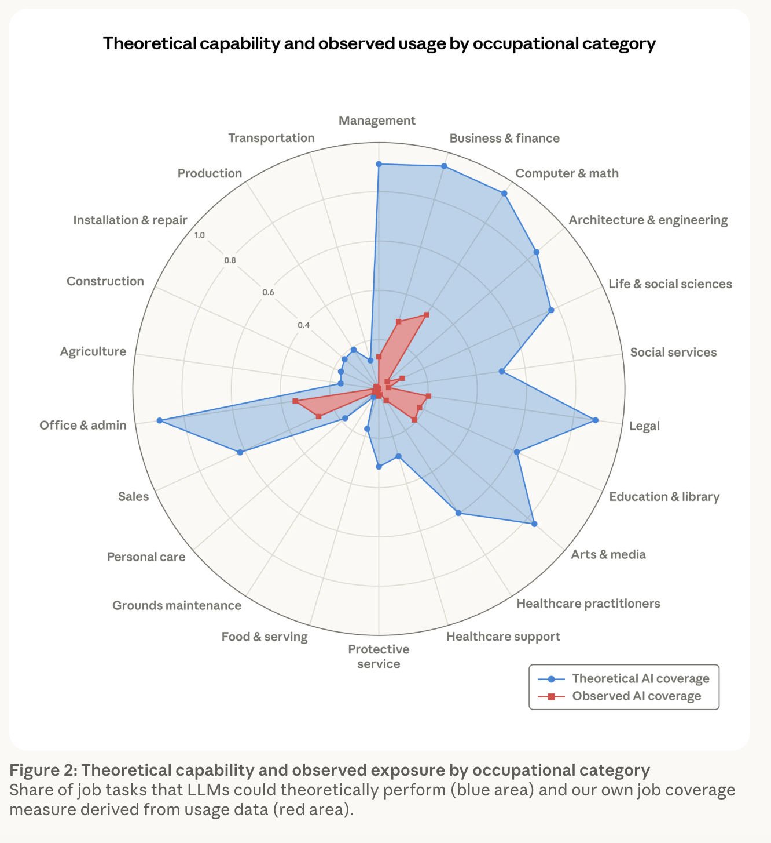
Exercise 1

Slide 10
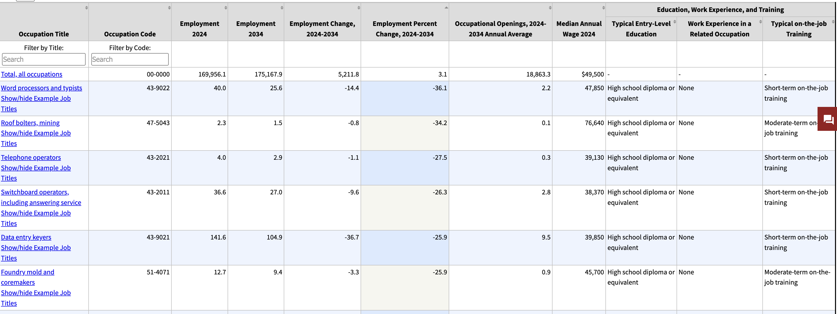
Exercise 1

Slide 11
What’s Important to Your Hypothetical Peer?
Economic Variables | AI / Technology Variables | Human Variables
Debt incurred in pursuing career | AI substitution risk | Career flexibility and ability to pivot
Expected lifetime earnings | AI augmentation potential | University and professional network
Expected near-term earnings | Job destabilization due to AI advancement | Human interaction career requirement
Wage growth | Data ownership impact on field | Geographic portability
Actual job placement | Remote work option | Skill portability
Job stability | Credential level required in career | Digital reputation dependency / personal branding
Entry-level job availability | Time to competency | Burnout risk
Regulatory barrier to entry | Energy demand & availability due to AI / industry growth | Life satisfaction (long term)
Economic opportunity within field of interest |  | Life satisfaction (short term)
Public/private infrastructure investment |  | Career longevity
Regional investment |  | Physical labor intensity
Government policy |  | Career resilience
Workforce shortage |  | Network strength and opportunity access
Aging population |  | Entrepreneurship potential
Environmental / geographic disruption risk |  | Meaning / Purpose Alignment
Skill scarcity

Slide 12
Tamalin and Bob Create their Hypotheticals!
Tamalin
Bob
Loves robotics
Hands-on learner
Wants stable income
Family is important
Strong mechanical aptitude
Top quarter of high school class
Strong writer
Interested in science
Values meaningful work
Concerned about debt
Wants flexibility
Weak family support network
Top 10% of their class

Slide 13
Exercise 2
Consider Stanford Canaries in the Coal Mine
Consider World Economic Forum – The Future of Jobs
Consider Higher Education in New York -- Evaluating Competitiveness and Identifying Challenges
How do these sources effect Tamalin and Bob?

Slide 14
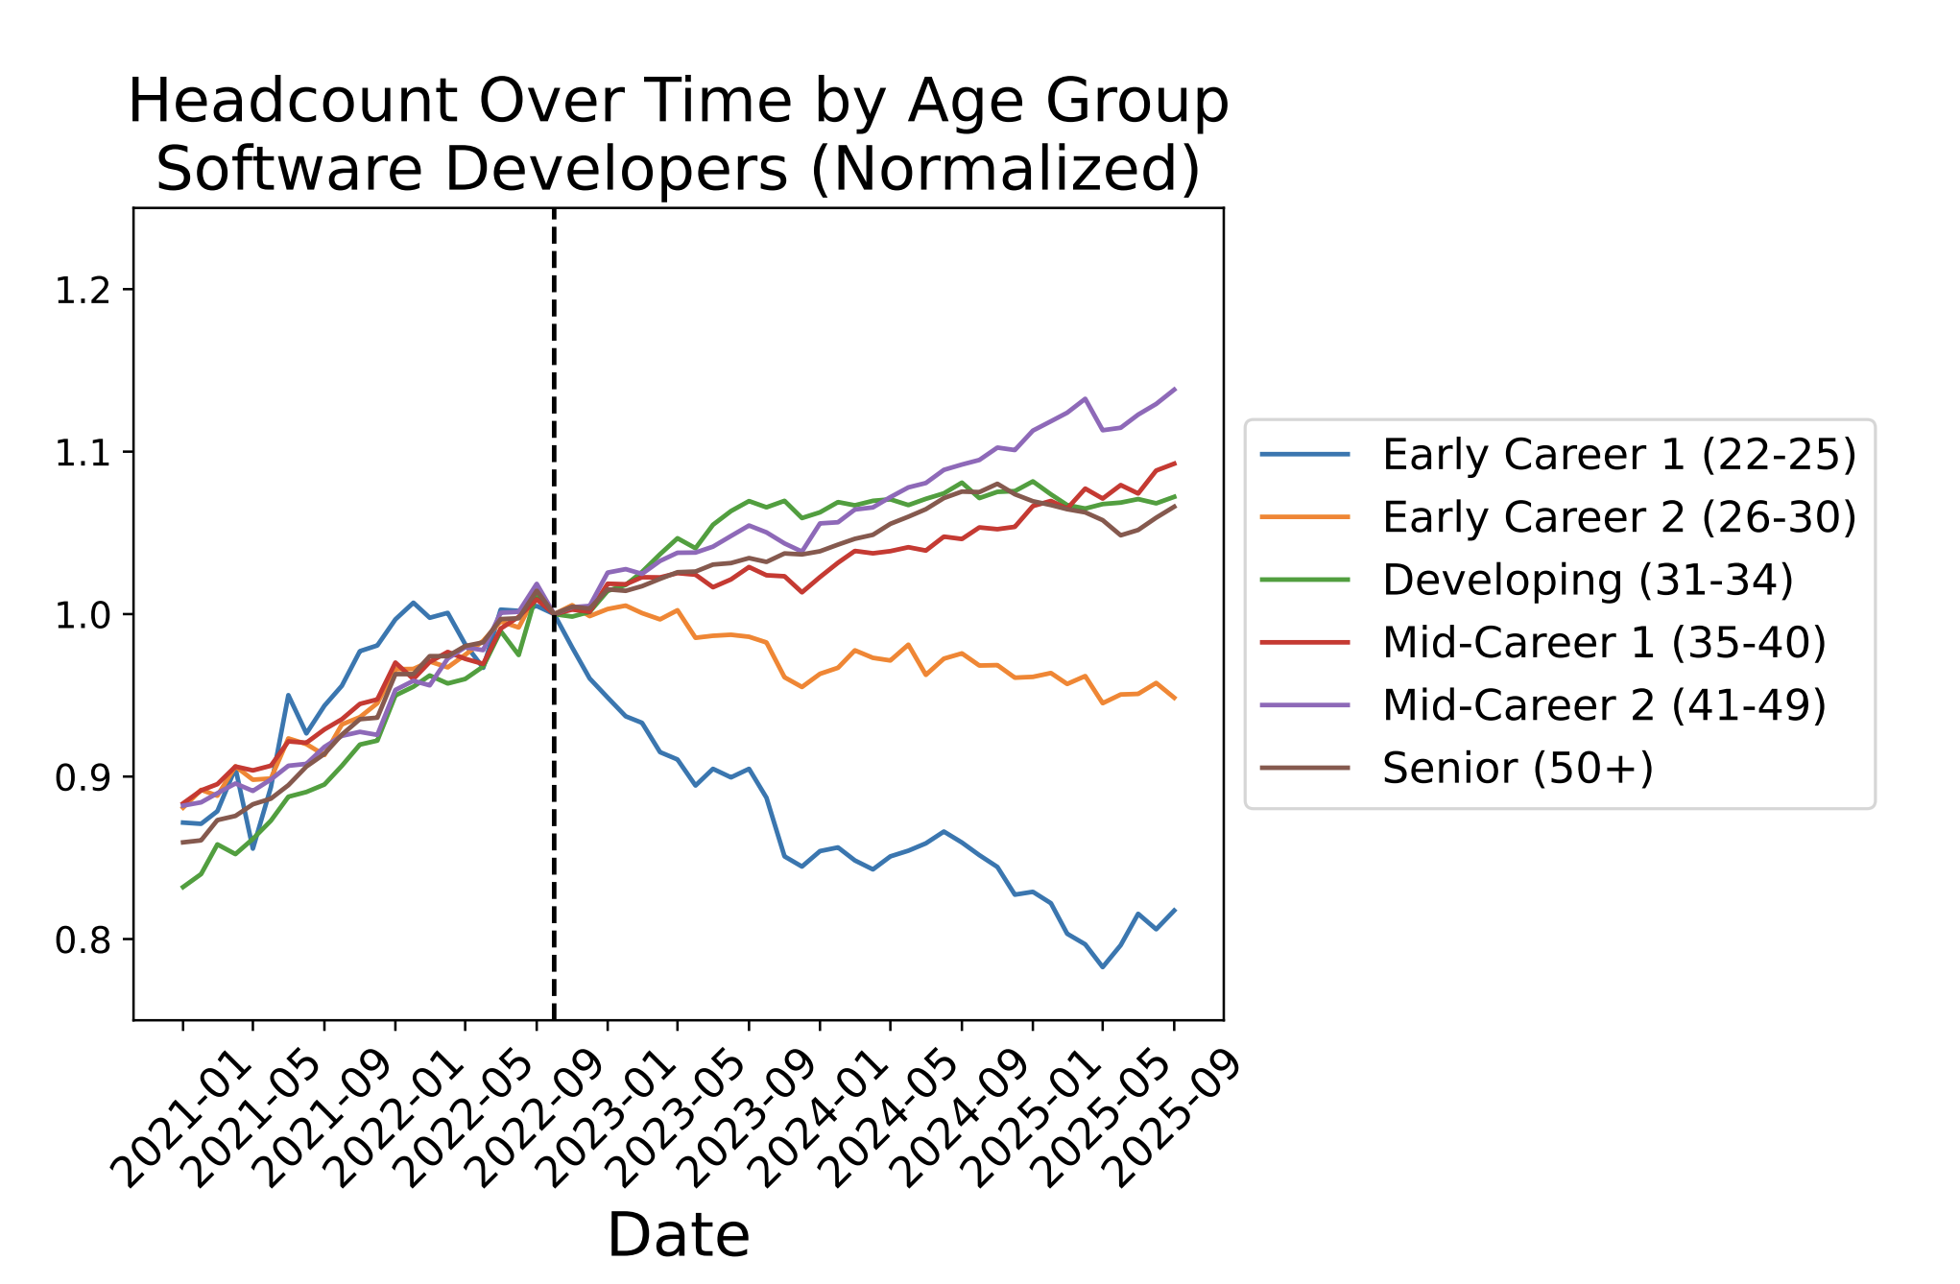
Exercise 2 -- Canaries in the Coal Mine
Huge Hidden Variable Alert!!!!!
What happened in 2022?
Release of ChatGPT
End of Technology Hiring Boom
Venture Capital Investment Decline
Post Pandemic Adjustments

Slide 15
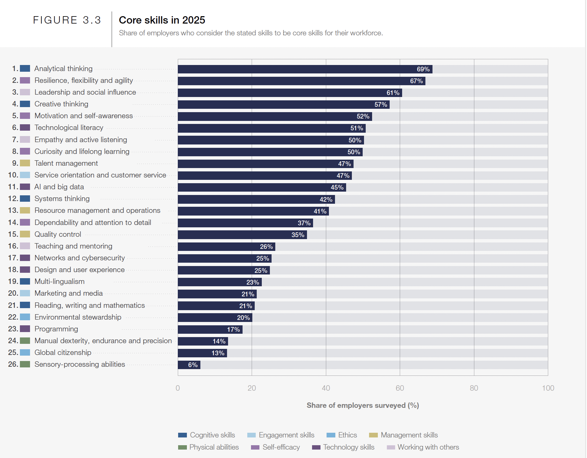
Exercise 2 -- The Future of Jobs

Slide 16
Exercise 2 -- Evaluating Competitiveness and Identifying Challenges
Escalating Costs of Attendance and Student Debt
  The cost of attending college or university is one of the most significant factors in deciding whether and where to go for a postsecondary education.
  Public four-year in-state tuition, fees, room and board of $24,231 per year

Slide 17
Questions and Discussion

